Slide 1

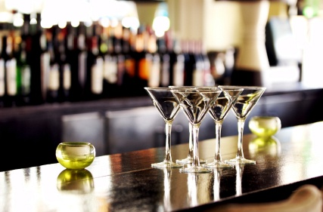
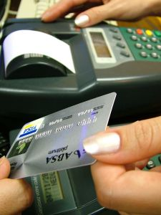
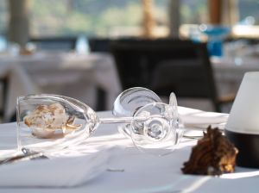
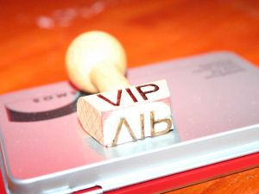
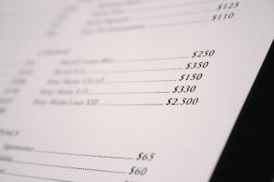
PROVIDE FOOD AND BEVERAGE SERVICES
D1.HBS.CL5.12
Notes:
Trainer welcomes trainees to class.

Slide 2
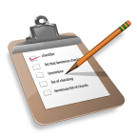
Subject Elements
This unit comprises nine Elements:
Prepare food and beverage environment for service
Set tables
Meet and greet guests
Take food and beverage orders
Serve food
Serve drinks
Present account to guest
Provide departure services
Conduct shut down activities
Notes:
Trainer advises that this Unit comprises nine Elements, as listed on the slide explaining:
• Each Element comprises a number of Performance Criteria which will be identified throughout the class and explained in detail
• Trainees can obtain more detail from their Trainee Manual
• At times the course presents advice and information about various protocols but where their workplace requirements differ to what is presented, the workplace practices and standards, as well as policies and procedures must be observed.

Slide 3
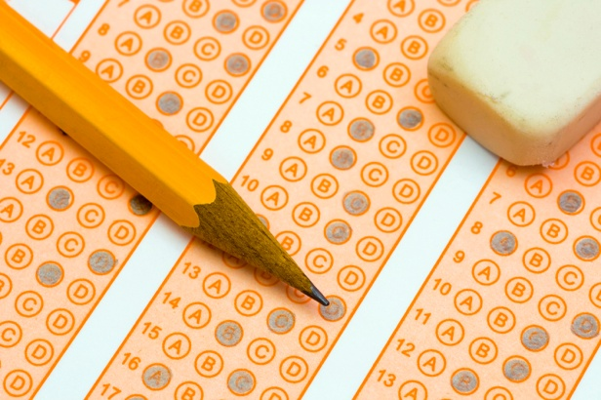
Assessment
Assessment for this unit may include:
Oral questions
Written questions
Work projects
Workplace observation of practical skills
Practical exercises
Formal report from supervisor
Notes:
Trainer advises that assessment for this Unit may take several forms, all of which are aimed at verifying they have achieved competency for the Unit as required.
Trainer indicates the methods of assessment that will be applied to them for this Unit.

Slide 4
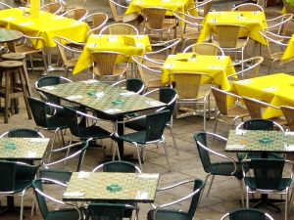
Element 1:
Prepare food and beverage environment for service
Notes:
Introduce topic.
Class Activity – General Discussion
Ask general questions:
What activities are conducted when preparing the food and beverage outlet for service?
Who would perform these functions?

Slide 5
Prepare food and beverage environment for service
Performance Criteria for this Element are:
Check requirements for the upcoming service session
Check cleanliness of the facility and conduct spot and makeup cleaning as required
Set up dining area for trading session
Process incoming reservations to the establishment
Notes:
Trainer identifies the Performance Criteria for this Element, as listed on the slide.

Slide 6
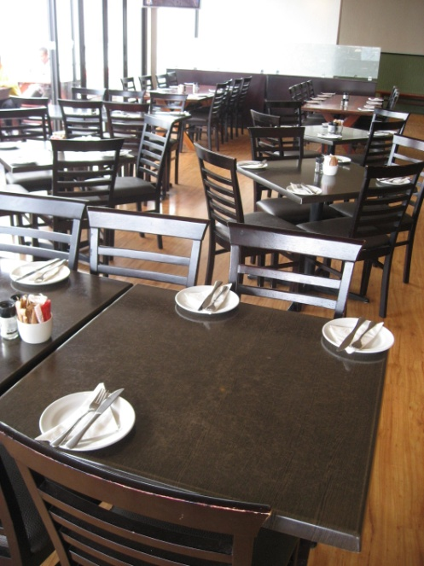
Preparing a food and beverage outlet
The preparation of a restaurant is vital for the efficient and successful running of any meal shift.
Things need to be:
Checked
Stocked
Cleaned
Positioned
Notes:
Class Activity – General Discussion and List
Get audience to answer following question:
Provide examples of what needs to take place under each preparation step.

Slide 7
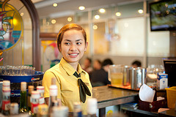
Types of food and beverage outlets
The industry boasts a wide variety of food and beverage outlets.
What types of food and beverage outlets exist?
What specific preparation activities need to be performed that are different from the norm?
Notes:
Class Activity – General Discussion and List
Get audience to answer the following questions:
Identify different types of eateries that exist ranging from fast food to formal dining and drinking
Identify what preparation needs to take place that is different?

Slide 8
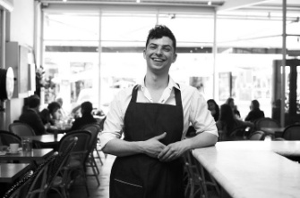
Identify individual responsibilities
Understanding your role
The basis of doing any job properly is knowing what is required of you, regardless of industry or position.
How can you find out what you are expected to do:
In your role?
For an upcoming shift?
Notes:
Discussion about how to identify individual job roles and responsibilities

Slide 9
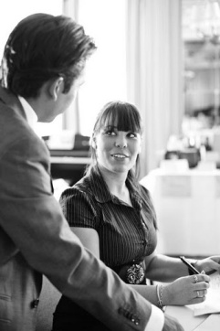
Understand upcoming session
Understanding the upcoming service session
Before we start to prepare for a session we must understand what is likely to take place in the upcoming session.
How can find out what impacts an upcoming session?
What are common impacts?
Notes:
Discussion about understanding upcoming sessions
Ask the questions in the slide.

Slide 10
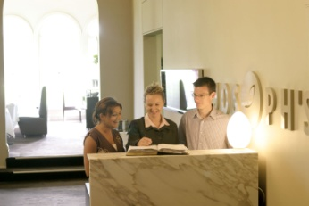
Understand upcoming session
Reservations
Number of guests
Size of bookings
Customer’s arrival time
Special requests
Needs of guests
Notes:
Class Activity – General Discussion
Get audience think about the impact these reservation details will have on an upcoming session.

Slide 11
Understand upcoming session
Considering anticipated trade
When checking reservations, it is also important to take into consideration the anticipated level of ‘walk in’ customers.
The level of ‘walk in’ trade may be influenced by:
Historical information
Events or local attractions
Weather
Hotel occupancy
Promotions
Notes:
Class Activity – General Discussion
What else can impact ‘walk in’ trade?
What types of F & B outlets have higher levels of walk in trade than others?

Slide 12
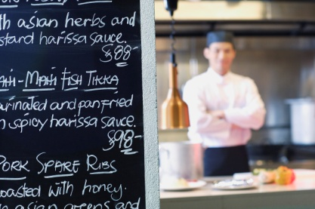
Understand upcoming session
Checking menu for the session
Fish of the day
Soup of the day
Specials of the day
Vegetables of the day
Dessert of the day
Specific constraints on this individual upcoming session
Out of stock items
Notes:
Class Activity – General Discussion
Who provides this information?
What other information may chefs provide to help understand an upcoming session?

Slide 13

Understand upcoming session
Checking internal requirements
Besides the above mentioned impacts on an upcoming session, there are usually a number of internal requirements that need to be considered.
What are some possible internal requirements?
Notes:
Class Activity – General Discussion
Discuss the question in the slide.

Slide 14
Check cleanliness of facility
Before the session starts it is imperative that the facility is clean.
Why is this important?
What areas do you check?
What do you need to check?
What cleaning activities may you need to conduct?
Notes:
Class Activity – General Discussion
Get audience to:
Provide examples of what needs to take place under each preparation step.

Slide 15
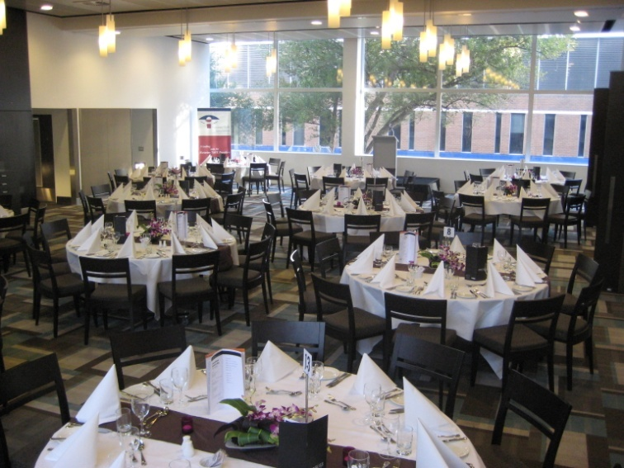
Checking and cleaning restaurant area
Areas to check for cleanliness may include:
Furniture – tables and chairs
Wall hangings – pictures or displays
Fixtures – light fittings and door knobs
Plants – indoor plants and pots
Operating equipment
Notes:
Class Activity – General Discussion
Get audience to:
Provide examples of what needs to take place under each preparation step.

Slide 16
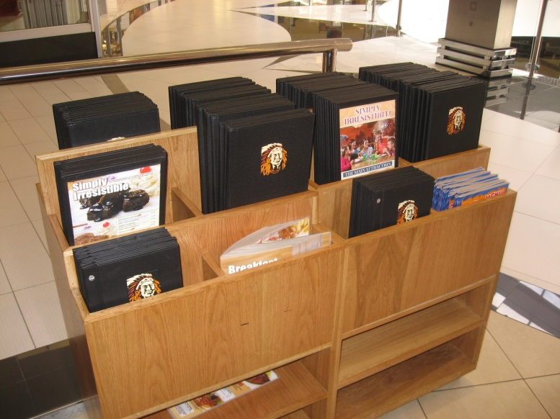
Checking and cleaning restaurant area
Areas to check for cleanliness may include:
Glass – windows, panels and doors
Floor – carpet and tiled areas
Work stations – waiter’s sideboard
Menu stands and Hostess stand
Toilets – rest areas
Buffet line
Bar
Notes:
Class Activity – General Discussion
Get audience to:
Provide examples of what needs to take place under each preparation step

Slide 17
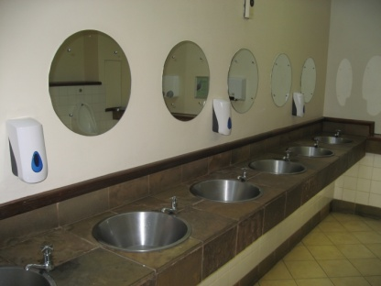
Checking and cleaning customer facilities
Other areas to check
Waiting area/foyer
Restrooms
Smoking areas
External areas
Notes:
Class Activity – General Discussion
What needs to be checked in each of these areas?

Slide 18
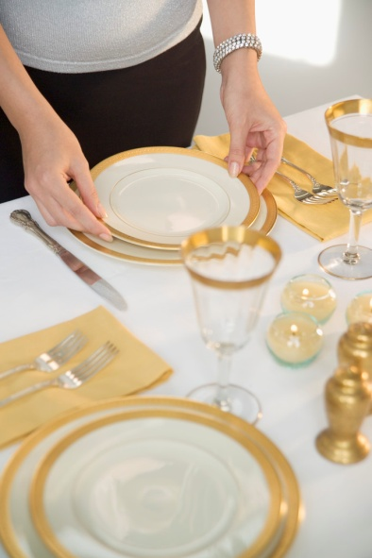
Setting up the dining area
After the facility is clean it is now time to ‘set up’ the dining area.
What needs to be set up?
Who performs it?
Notes:
Class Activity – General Discussion
Discuss the questions in the slide.

Slide 19
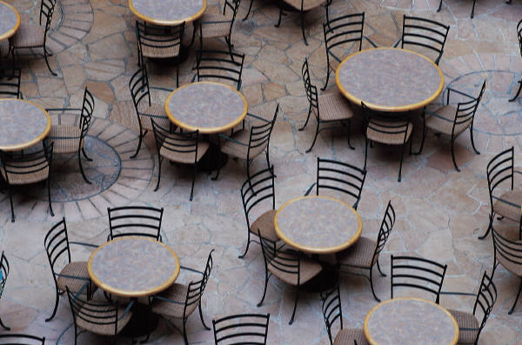
Set up furniture
A major task in preparing a food and beverage service area for service is to set up the furniture in the room
‘Furniture’ primarily refers to tables and chairs
Notes:
Class Activity – General Discussion
Get audience to answer the following questions:
What furniture is needed in a restaurant?
What determines their style and layout?

Slide 20
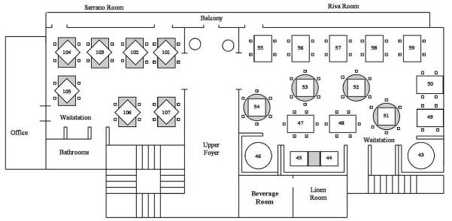
Set up furniture
Floor plan
A floor plan is a map of how the tables are to be positioned in a dining area/restaurant.
Notes:
Class Activity – General Discussion
Get audience to answer the following question/s:
What does a manager need to consider when thinking about a floor plan?

Slide 21
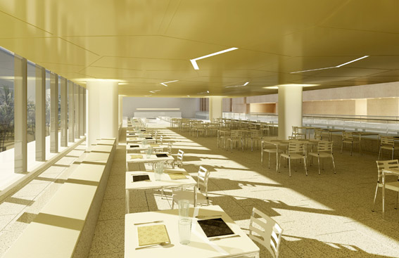
Set up furniture
Floor plan
A floor plan sets out:
Where the tables will be physically positioned
The number of covers on each table
The table numbers
Which waiters will serve which tables
Notes:
Class Activity – General Discussion
Get audience to answer following question/s:
What does a manager need to consider when thinking about a floor plan?

Slide 22
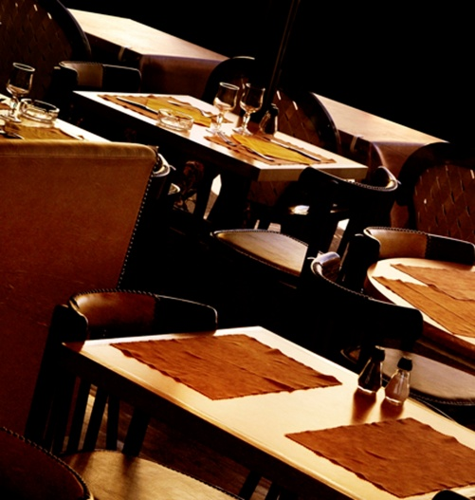
Set up furniture
Floor plan considerations
Reservations
Shape and design of the room
Immovable objects
Style of furniture
Exits and doors
Customer and service personnel access
Notes:
Class Activity – General Discussion
Discuss how these points affect the floor plan and how tables will be set out.

Slide 23
Allocating sections to staff
Allocating waiting stations to staff
Once the tables have been set up, it is quite common for the manager to assign sections and tables to specific staff members.
What ways can this be determined?
What are common ‘staff to customer’ ratios?
What else needs to be considered?
Notes:
Class Activity – General Discussion
Discuss the questions in the slide.

Slide 24
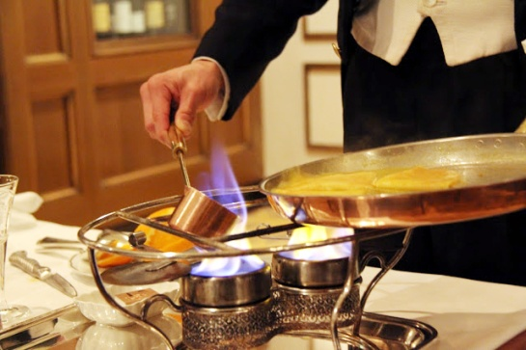
Allocating sections to staff
Considerations
Types of customers
Amount of people per table
Type of service
Level of service
Experience of staff
Location of tables
Notes:
Class Activity – General Discussion about factors influencing allocation of tables to servers
Types of customers. Some customers will be more difficult to service including parties or those with many special requests. Also VIPs may require more attentive service
Amount of people per table. It is easier to service two tables of 10 customers than 10 tables of 2 customers. Hence staff may be given a maximum of 5 tables
Type of service. If customers are eating from a buffet or from a set menu, the amount of tasks to be performed by waiters will be reduced, therefore more customers may be allocated
Level of service. Where staff are required to provide gueridon service, involving preparing or cooking dishes at the table, the amount of customers they will be able to professionally service will reduce dramatically
Experience of staff. Naturally new staff will not be able to deal with larger numbers of customers. In addition where experienced staff are training new staff, their expected level of productivity with be reduced
Location of tables. Where tables are located a great distance from food outlets, kitchens or work stations, more time will be required to travel between these locations.

Slide 25
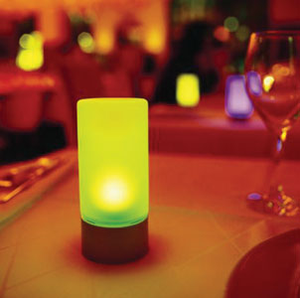
Prepare comfort and ambiance
The ambience and comfort level of a restaurant must be taken into consideration when preparing for service.
This normally takes into consideration:
Temperature
Noise
Lighting
Notes:
Class Activity – General Discussion
Get audience to answer the following questions:
How can you create ambiance and comfort taking into consideration each of these points?
Why is it important for patrons?

Slide 26
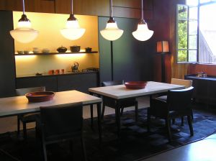
Prepare comfort and ambiance
Other considerations
Table decorations
Floor displays
Smells
What other ways can you create comfort and ambiance?
Notes:
Class Activity – General Discussion
Get audience to:
Think of other ways to create comfort and ambiance.

Slide 27
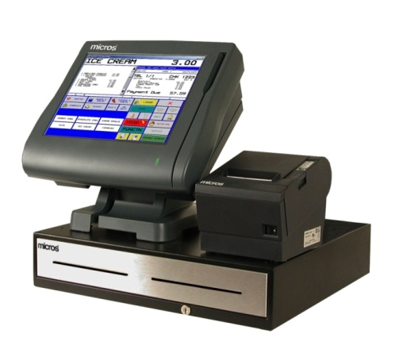
Prepare equipment
Once the restaurant area is ready for service, it is now time to prepare the equipment.
What equipment items need to be prepared?
What auxiliary items that accompany equipment need to be set up?
Notes:
Class Activity – General Discussion
Get audience to think about and identify all equipment and auxiliary items that need to be prepared.

Slide 28
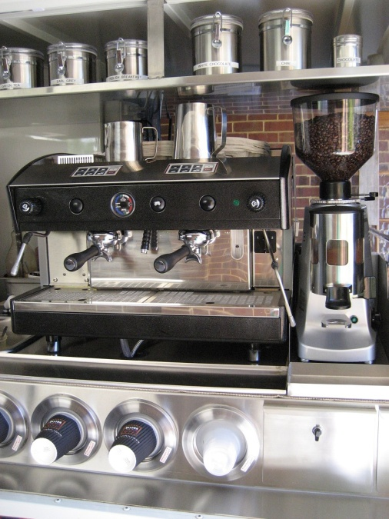
Prepare equipment
Coffee Area
Coffee machine
Cups
Saucers
Teaspoons
Sugar
Milk jugs
Types of milk
Types of coffee
Accompaniments (biscuits)
Napkins
Notes:
Class Activity – General Discussion
Discuss the steps associated with setting up a coffee area.

Slide 29
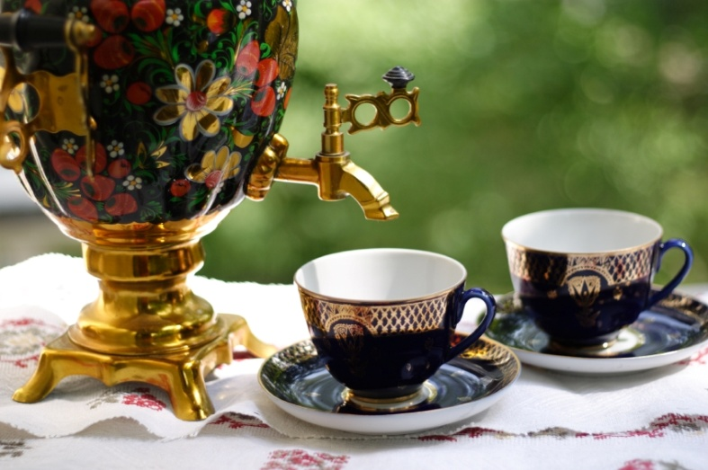
Prepare equipment
Tea Area
Cups
Saucers
Teaspoons
Sugar
Milk jugs
Types of tea
Lemon
Notes:
Class Activity – General Discussion
Discuss the steps associated with setting up a coffee area.

Slide 30
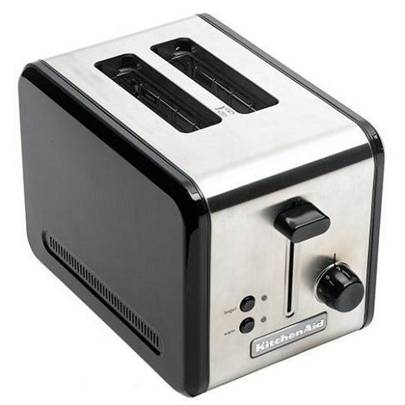
Prepare equipment
Service Equipment
Bain-maries
Toasters
What other service equipment is used?
Notes:
Class Activity – General Discussion
Discuss the steps associated with organising other equipment.

Slide 31
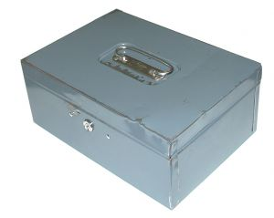
Prepare cash register station
Receive cash float
A cash float is the amount of money that an establishment has deemed appropriate to commence the day’s trading for a cash register/point-of-sale (POS) terminal
It is used for giving change when completing transactions
Notes:
Trainer to detail and explain what is a ‘float’.
Activity: Discussion
Explain the steps associated with collecting a cash float.

Slide 32
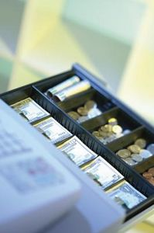
Prepare cash register station
What is a cash register?
A cash register is a machine that is used to accurately record transactions:
Charges and methods of payments
Issue accounts and receipts
Store cash and non-cash payments
Notes:
Trainer explains the purpose of a cash register.
A cash register is a machine that is used to accurately record transactions (both charges and methods of payments), issue accounts and receipts and to store cash and non-cash payments.
Activity: Demonstration
Trainer to demonstrate the functions of a cash register.

Slide 33
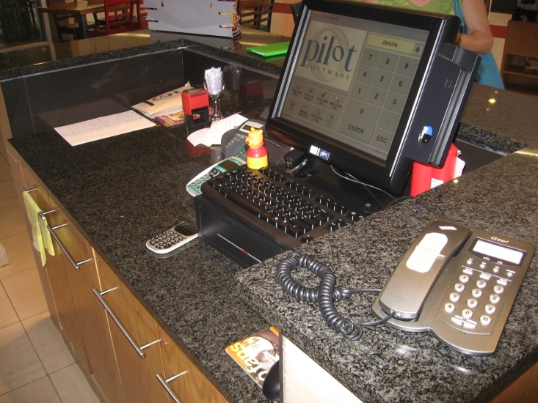
Prepare cash register station
Prepare register items
Ensure an adequate supply of:
Cash register paper
Pens
Receipt paper
Account folders
Ink cartridge
Notes:
Trainer explains the tasks to be performed when preparing a register area.
Discuss points.

Slide 34
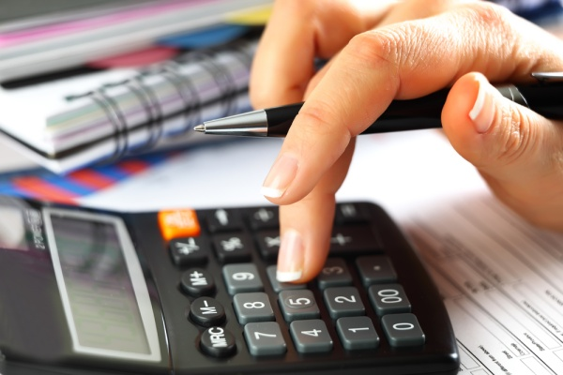
Prepare cash register station
Prepare register items
Cash register paper
Sweets or other gifts normally presented with accounts to customers
Rubbish bins
Spare paper
Calculator
Currency exchange sheet
Notes:
Trainer explains the tasks to be performed when preparing a register area.
Discuss points.

Slide 35
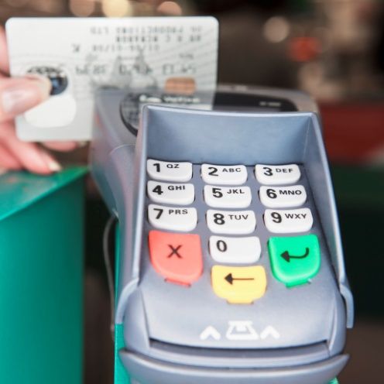
Prepare cash register station
Prepare register equipment
Besides the register there are other machines that must be checked:
ETFPOS machines
Manual credit card machines
Notes:
Trainer explains the tasks to be performed when preparing a workstation.
Besides the cash register there are other machines that must be checked before the start of the shift. These include:
ETFPOS machines
Manual credit card machines.
Activity: Demonstration
Trainer to demonstrate the functions of an EFTPOS and manual credit card machines.

Slide 36
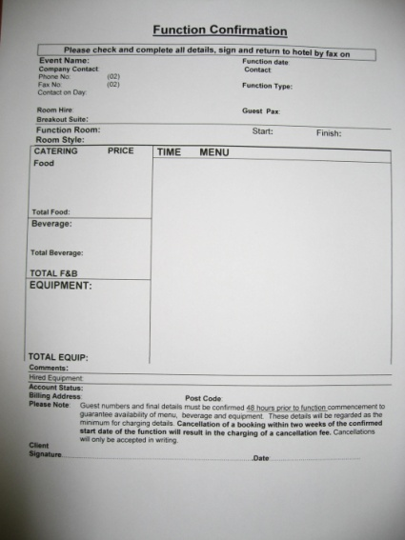
Prepare cash register station
Prepare associated information
It is important to have a clear understanding of information that may effect cashiering duties for the day including:
Function sheets including event items, pricing, contact names and authorisation information
Methods of payment for VIP or special groups or customers
Prices for new menu items, specials of the day or promotions
Notes:
Trainer explains the tasks to be performed when preparing a workstation.

Slide 37
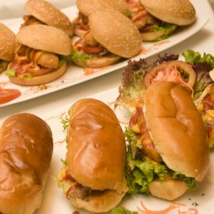
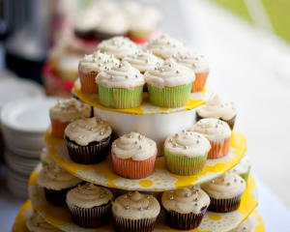
Display food and beverage items
What food and beverage items are commonly displayed?
Where are they displayed?
How do staff promote them?
How do you display hot food in a hygienic manner?
How do you display cold food in a hygienic manner?
Notes:
Class Activity – General Discussion
Get audience to think about food and beverage items displayed in an outlet.

Slide 38
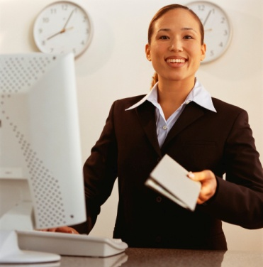
Process incoming reservations
As tables have been allocated to incoming reservations, it is vital to ensure that the reservations are in fact accurate and that the people are coming.
Why is it important to follow up reservations?
What information needs to be confirmed?
What resulting actions need to take place?
Notes:
Class Activity – General Discussion
Discuss the questions in the slide.

Slide 39
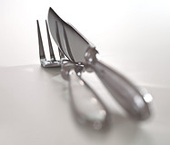
Process incoming reservations
Importance of following up
Proves to the customer we value their patronage
Reminds the customer of reservation
Confirms that the reservation is still applicable
Ensure space is confirmed
Tables can be resold or released if not wanted
Information or arrangements can be confirmed
Notes:
Class Activity – General Discussion
Discuss the importance of following up reservations.

Slide 40
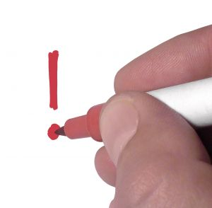
Process incoming reservations
Importance of following up
Payment methods can be collected
Ensures changes can be accommodated before the customer arrives
Where booking charges can be explained and processed
Explain parking arrangements
Waiting list customers can be contacted
Notes:
Class Activity – General Discussion
Discuss the importance of following up reservations.

Slide 41

Process incoming reservations
Reservation information to confirm
Status of the reservation – confirmed or cancelled
Name of booking
Number of pax
Expected time of arrival
Any special requests
Confirm existing requests
Notes:
Class Activity – General Discussion
Is there any other information to follow up?

Slide 42
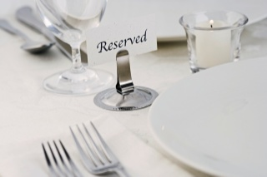
Process incoming reservations
Follow up activities
Placing reserved sign on the table
Informing waiters of the tables under their responsibility of reservation details and requests
Informing kitchen of any requests
Follow up on any requests
Phoning people on the waiting list if the previous reservation is now cancelled
Processing charges as applicable
Notes:
Class Activity – General Discussion
What other activities need to take place?

Slide 43
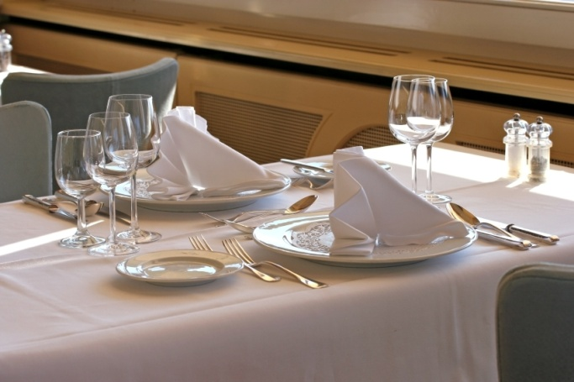
Element 2:
Set tables
Notes:
Introduce topic.
Class Activity – General Discussion
Ask general questions:
What activities are associated with setting tables?
What else needs to be set up?

Slide 44
Set tables
Performance Criteria for this Element are:
Match table setting to menu for the session
Set tables and dress where appropriate
Complete final inspection of room and table set ups
Identify and report recurring problems with set up to the appropriate person to prevent recurrence
Notes:
Trainer identifies the Performance Criteria for this Element, as listed on the slide.

Slide 45
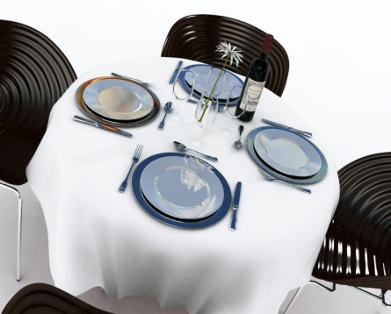
Setting tables
Once the room setting and equipment is set up it is now time to set the tables to meet the expected trade for the meal period.
What types of setting can you prepare?
What cutlery and crockery is needed?
Notes:
Class Activity – General Discussion
Discuss the different types of settings:
What cutlery is needed for these settings?
What crockery is needed for these settings?

Slide 46
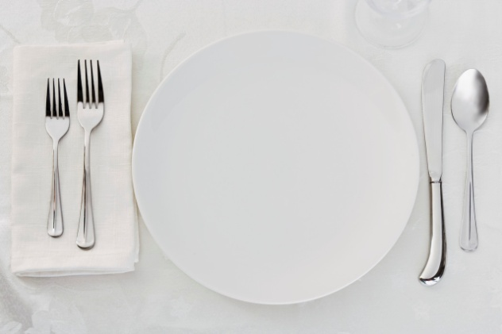
Setting tables
A cover
A place setting for one guest is commonly known in the industry as a ‘cover’.
Notes:
Class Activity – General Discussion
What is a cover?

Slide 47
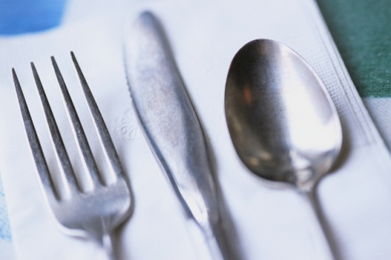
Setting tables
A la carte setting
A la carte is the term used for a menu that has individually priced dishes
These dishes are divided into entrées, salads, mains and desserts
A la carte means ‘from the card/menu’
This type of setting is popular
Notes:
Class Activity – General Discussion
What items are included in a la carte cover?
What types of food and beverage establishments use this type of cover?

Slide 48

Setting tables
A la carte setting
This setting usually consists of:
Main course knife
Main course fork
Side plate
Side knife
Wine glass
Napkin
Centre pieces
Notes:
Class Activity – General Discussion and Demonstration
What are common centre pieces?
These include salt and pepper shakers, table numbers, vases or tent cards.
The trainer may demonstrate setting this type of cover, explaining the reasoning behind it.

Slide 49
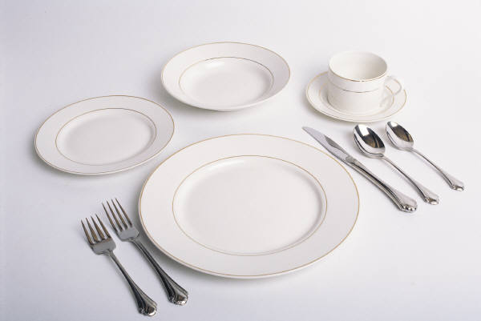
Setting tables
Table d’hôte setting
A table d’hôte menu is a menu that has a set price for a number of courses
‘Table d’hôte’ means ‘table of the host’
All courses are included in the price and must be paid for by the guests even if they don’t eat every course
This is often called a ‘set menu’
Notes:
Class Activity – General Discussion
What items are included in a table d’hôte cover?
What types of food and beverage establishments use this type of cover?

Slide 50
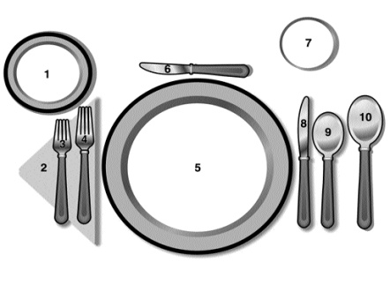
Setting tables
Table d’hôte setting
The setting for this menu would be:
Main course knife and fork
Entrée knife and fork
Dessert spoon and fork
Side plate and knife
Wine glass
Napkin
Centre pieces
Notes:
Class Activity – General Discussion and Demonstration
What variations exist to this setting?
The trainer may demonstrate setting this type of cover, explaining the reasoning behind it.

Slide 51

Types of functions
There are many types of functions, each with their own requirements.
What functions are commonly held in a hotel?
What table settings are used?
What else needs to be prepared?
Notes:
Class Activity – General Questions
Discuss the questions in the slide.

Slide 52
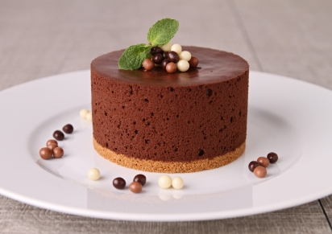
House specials
Every food and beverage establishment will have a specific focus in which most or all of its dishes are centred around. This could include specific:
Themes
Cuisines
Specials of the day
Promotions
Favourites or popular items
Notes:
Class Activity – General Questions
Discuss these different types of house specials.

Slide 53
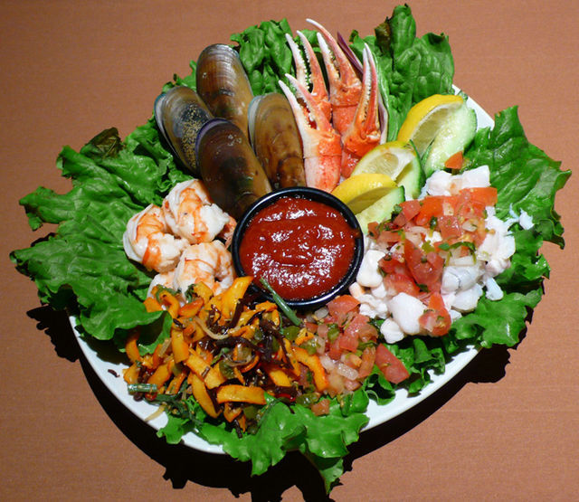
Meal periods
Naturally each meal period will require different settings, appropriate to what is being served.
What different meal periods are there?
What types of food and beverage are provided?
How should tables be set for these?
Notes:
Class Activity – General Discussion
Discuss the questions in this slide.

Slide 54
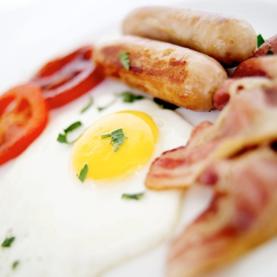
Meal periods
Breakfast menu
Morning/afternoon teas
Lunch menu
Dinner menu
Seminar/conference
Wedding
Cocktail parties
Promotions and product launches
Notes:
Class Activity – General Discussion
Trainer to discuss the different menu items and how they would best be served for each of these meal periods.
Trainer may show examples of menus relating to these meal periods.

Slide 55

Styles of service
There are many styles of service that require different settings.
What styles of service do you know?
How are table settings influenced?
Notes:
Class Activity – General Questions
Discuss the questions in the slide.

Slide 56

Styles of service
Plated service
Kitchen plates all the food and the waiting staff carry the plated food to the table.
The benefits of plated service are:
Consistency of meals
Fast service
Portion control
Notes:
Class Activity – General Questions
In what types of functions is this style of service popular?

Slide 57

Styles of service
Silver service
Food items are prepared and carved or separated into individual portions and placed on platters by kitchen staff.
Waiting staff use spoons and forks to serve food from service platters
The benefits of silver service are:
Adds a dimension of ‘entertainment and sophistication’
Customers can have greater choice
Notes:
Class Activity – General Questions
In what types of functions is this style of service popular?

Slide 58

Styles of service
Semi-silver service
The meat component of the dish is plated and served, and the vegetables are silver served
The benefits of semi-silver service are:
It increases options for customer
It is a more time efficient use of silver service
Notes:
Class Activity – General Questions
In what types of functions is this style of service popular?

Slide 59

Styles of service
Gueridon service
Food is prepared or cooked at the table and served using full silver service techniques.
The benefits of gueridon service are:
It is a form of entertainment
It is interactive
It allows customers to see the cooking process
Meals can be prepared to customers’ exact specifications
Notes:
Class Activity – General Questions
In what types of functions is this style of service popular?

Slide 60


Styles of service
Buffet service
Food is prepared in kitchens in large quantities and then placed on a buffet or display table
In most buffet situations guests serve themselves and select the items and quantities they desire
Notes:
Class Activity – General Questions
In what types of functions is this style of service popular?

Slide 61

Styles of service
Cocktail service
This style of service is very popular, either as a prelude to a dinner or as a stand alone function in its own right
Waiters providing a range of finger foods and beverage to customers in a stand up function
Notes:
Class Activity – General Questions
In what types of functions is this style of service popular?

Slide 62

Set and dress tables
One of the most important steps when setting up for service is to ensure that the tables are set up to meet the requirements of the upcoming session.
What are the objectives when setting and dressing a table?
What needs to be set up?
What preparation tasks are to done?
How do you ‘dress’ a table?
Notes:
Class Activity – General Discussion
Discuss the questions in the slide.

Slide 63

Set and dress tables
Importance of professional table settings
A great deal of work and attention to detail must be applied when setting tables, as they must:
Have all the necessary tableware, centrepieces, napkins and condiments
Must be complete
Must be clean and hygienic
Must be uniform and consistent throughout the outlet
Notes:
Class Activity – General Discussion
Why are these points important?
What else is important?

Slide 64

Prepare napkins
Napkins
Preparing napkins includes ensuring they are:
Clean
Have no holes
Are prepared and folded
Notes:
Class Activity – General Discussion
Discuss the different types of napkin materials used in a food and beverage outlet?
In what forms are napkins commonly found (packaged and disposable etc.)?

Slide 65

Prepare napkins
Napkins
Types of napkin folds:
Cone
Bishops Hat
Fan
Opera House
Sail
Notes:
Class Activity – General Discussion and Demonstration
What are common folds?
Trainer may demonstrate a number of common napkin folds.

Slide 66

Prepare cutlery
Cutlery
Knives (main and entrée)
Forks (main and entrée)
Soup spoons
Dessert spoons
Hot chocolate spoons
Teaspoons
Seafood cutlery
Notes:
Class Activity – General Discussion
Discuss the different types of cutlery used in a food and beverage outlet.
How can you ensure cutlery is clean?

Slide 67

Prepare crockery
Crockery
Plates (main and entrée)
bowls (soup, salad and dessert)
Butter dishes
Salt and pepper shakers
Sugar bowls
Notes:
Class Activity – General Discussion
Discuss the different types of crockery used in a food and beverage outlet.
How can you ensure crockery is clean?

Slide 68

Prepare glassware
Glassware
Beer glasses
Wine glasses
All-purpose glasses
Cocktail glasses
Liqueur glasses and fortified wine glasses
Carafes wines to table
Jugs drinks
Irish coffee mugs
Notes:
Class Activity – General Discussion
Discuss the different types of glasses used in a food and beverage outlet.
How can you ensure glassware is clean?

Slide 69

Prepare shakers
Prepare salt and pepper shakers
Before each shift, salt and pepper shakers must be checked to ensure they are clean and filled appropriately.
Blocked holes should be unblocked
The exterior of the shakers must be clean
Tops free from residual salt or pepper
Tops are firmly in place
Notes:
Class Activity – General Discussion
Why are these points important when preparing salt and pepper shakers?

Slide 70

Setting tables
Clothing a table
Clean linen
Never let cloth touch ground
Lay right side up
Same level of overhang on each side
Crease middle if using more than 1 cloth
Creases should not be seen at the door
Use clean napkins
Notes:
Class Activity – General Discussion and Demonstration
What items are included in clothing a table?
The trainer may demonstrate clothing a table.

Slide 71

Setting tables
Dressing a table
On special occasions, or as part of standard operating procedures, tables may need to be dressed.
Dressing takes place as part of the set up and enhances presentation of the table.
How do you dress a table?
What does boxing a table mean?
What tables are normally boxed or dressed?
Notes:
Class Activity – General Discussion and Demonstration
Discuss the questions in the slide.
The trainer may demonstrate dressing and boxing a table.

Slide 72

Setting tables
Tips for setting a table
Use the guest’s chair as a guide to centre the cover
Side plates should be placed to the left of the fork
Knife blades should always face left
Sufficient space should be left between the knife and fork for the plate to be placed down
Notes:
Class Activity – General Discussion
Discuss the reasoning behind these tips.

Slide 73

Setting tables
Tips for setting a table
Entrée cutlery should always be placed on the outside of the main course cutlery
In à la carte dining, the dessert cutlery should be placed where the main course knife is usually positioned
Wine glass should be placed directly above the main knife
Notes:
Class Activity – General Discussion
Discuss the reasoning behind these tips.

Slide 74

Place table accoutrements
‘Accoutrements’ are the items used to fit out the tables.
In some situations you may be required to dress tables with accoutrements such as:
Candlesticks
Candelabra
Bud vases
Overlays
Floral arrangements
Placemats
Notes:
Class Activity – General Discussion
What else can you use?
What is the purpose of these items?

Slide 75


Prepare other items
Condiments
Butter
Lemon and lime
Waiters station
Notes:
Class Activity – General Discussion
Discuss the different types of items that need to be prepared for these points.

Slide 76

Complete final inspection of room
Now that tables are set for service and the room is clean and tidy it is now time to undertake a final inspection of the room and table set ups.
What would you check?
What are you looking for?
Notes:
Class Activity – General Discussion
Discuss the questions in the slide.

Slide 77

Removing, cleaning or replacing items
High chairs
Trestle tables
Bain-maries
Coffee urns
Equipment used only for the breakfast shift
Glassware
Notes:
Class Activity – General Discussion
If you remove these items, where do you place them?
When would they be needed again?

Slide 78

Removing, cleaning or replacing items
Broken equipment or furniture
Used customer comment forms
Stock (food and beverage items)
Displays
Mobile trolleys
Notes:
Class Activity – General Discussion
If you remove these items, where do you place them?
When would they be needed again?

Slide 79

Setting tables
Checking tables prior to service
Cleanliness and the condition of the tables and the table items must be checked prior to service to ensure the guests enter a proper and correctly prepared room.
What would you check and why?
Notes:
Class Activity – General Discussion
What would you check and why?

Slide 80
Setting tables
Checking tables prior to service
Crumbs on chairs
Lop-sided, creased, dirty or otherwise unsuitable table cloth
Missing items from the cover or table
Missing, damaged or unstable tables and chairs
Incorrect covers set on a table
Actual table positions reflect the set floor plan
Rubbish
Flies or insects
Notes:
Class Activity – General Discussion and Demonstration
Crumbs on chairs left from the previous session. Cleaners will clean the floor of the room but rarely be required to clean chairs
Lop-sided, creased, dirty or otherwise unsuitable tablecloth
Missing items from the cover or table – crockery, cutlery, centre pieces, glassware, napkins, tent cards
Missing, damaged or unstable tables and chairs
Incorrect covers set on a table. The covers must reflect the number of guests for each table as indicated on the floor plan. Where tables exist that do not have bookings, most venues will prepare tables to suit the size of walk-in numbers/parties that can be reasonably expected. This means they may set up a number of tables for two, some tables for four people and some for (perhaps) six or eight people
That the actual table positions reflect the set floor plan
Rubbish on the floor, in pot plants etc
Flies or insects – alive or dead, with special attention being paid to window ledges.

Slide 81


Setting tables
Verify Menu
Types of menus
A la carte menu
Set menu
Beverage menu
What is in the beverage menu?
Notes:
Class Activity – General Discussion
What information should you verify?
Who provides this information?

Slide 82
Final check
Final confirmations
As part of the final check a final confirmation of the following may take place:
Bookings
Special requests
Seating plan
Station allocations
Notes:
Class Activity – General Discussion
Why is this important to check again?

Slide 83

Reporting problems
Once a final check of the restaurant has been completed, any problems that have been identified can be discussed with the appropriate person, for their prompt action.
There may be times when service staff identify a problem they cannot rectify, or come across a recurring problem in the room.
What are common problems?
Who should they be reported to?
Notes:
Class Activity – General Discussion
Discuss the questions in the slide.

Slide 84

Reporting problems
Common recurring problems
A piece of equipment keeps failing
Faulty refrigeration
Running out of crockery, cutlery or glasses
Always running out of forms or pens
Circuit breakers constantly tripping
Faulty air conditioning
Production delays
Miscommunication between customers & staff
Notes:
Class Activity – General Discussion
Why are these problems common?
Who should they be reported to?
What can you do whilst the problem is being fixed?

Slide 85

Reporting problems
The floor plan always gets lost
The need for a new piece of equipment to complete a specific task more efficiently
Any health and safety issue
Always running out of a particular product
Always running out of ice
Always running out of menus
Need for more cleaning items and equipment
Notes:
Class Activity – General Discussion
Why are these problems common?
Who should they be reported to?
What can you do whilst the problem is being fixed?

Slide 86

Element 3:
Meet and greet guests
Notes:
Introduce topic.
Class Activity – General Discussion
Ask general questions:
How do you greet customers?
What do you ask?
Why is it important to acknowledge customers upon arrival in a prompt manner?

Slide 87
Meet and greet guests
Performance Criteria for this Element are:
Welcome guests on arrival
Seat guests at nominated or designated tables
Offer pre-meal services
Present menus and wine/drink lists
Provide service advice and information to guests
Notes:
Trainer identifies the Performance Criteria for this Element, as listed on the slide.

Slide 88

Welcoming guests
You never get a second chance to make a good first impression
What is a good way to welcome customers to a food and beverage establishment?
Notes:
Class Activity – General Discussion
What is a good welcome?

Slide 89

Check reservations
Name of booking
Reservation/No reservation
Confirm number of guests
Smoking and non smoking
Special requests
Notes:
Class Activity – General Discussion
Where are reservations normally kept?
What happens if a customer says they have a reservation but it cannot be found in your records?

Slide 90

Greeting
Give an appropriate greeting
What is a good way to greet a customer?
What is ‘ice-breaking’ conversations that you can initiate?
Notes:
Class Activity – General Discussion
Suggested topics include:
The weather – a genuine comment: “Isn’t it cold today?” – can be a great ice-breaker and help strike up a conversation
Sporting events – “Did you watch the game today?”
Special events – “Happy Festival Day”
The season – “Isn’t it getting dark early these days?”
A special in-house event – “Welcome to our Grand Winery Tour Dinner, it will be a night to remember!”

Slide 91
Special needs customers
Making suitable accommodation
Alternative easy access to their table because of a disability
Privacy for romantic couples and business people
Room on a table to spread out business documents
A table near the door for someone with a walking stick
A high chair for infants
Warming of a bottle for babies
Special dietary needs
Notes:
Class Activity – General Discussion
In a given restaurant setting, how would you accommodate these special needs?

Slide 92

Escort and seat customers
“Follow me”
Walk at a comfortable pace
Acknowledge any dangers
Pull out chairs
Push in chairs
Ensure adequate seating
Remove excess chairs
Lap napkins
Communication
Notes:
Class Activity – General Discussion and Demonstrate
Demonstrate how to undertake escorting activities.

Slide 93

Pre-meal services
Offer pre-meal services
Seat
Magazine/newspaper
Menu
Beverage
Snack
Notes:
Class Activity – General Discussion
How would you offer these pre-meal services?

Slide 94

Present menus
Ensure there are adequate menus for everyone to read
Provide menus suitable for the customers:
Different languages
Children’s menus
Distribute menus to the guests from their right-hand side
Leave the wine list with the host or place in the centre of the table
Notes:
Class Activity – General Discussion
Discuss points.

Slide 95

Present menus
Ask customers if they would like any starters
Serve any complimentary starters
Point of direct customers to other menus:
Fixed menus on walls
Daily specials
Tent card displays on tables
Tell customers you will be back in a minute to discuss the menu
Notes:
Class Activity – General Discussion
Discuss points.

Slide 96

Offering advice and information
Most customers who visit a food and beverage establishment will not have the same level of knowledge about the menu offering as staff.
Therefore they may not be aware of:
What is available
Which ones are the specialty items
What promotions exist
Notes:
Questions
When is the best time to give advice?
What signs do you look for when deciding whether to give advice or not?

Slide 97

Offering advice and information
Asking questions
What investigatory questions can you ask to help identify their desired food and beverage needs?
Notes:
Questions
Ask the question in the slide
Compile a list of suitable questions.

Slide 98

Offering advice and information
Giving general information
The most common form of assistance to be provided will evolve around helping to clarify:
Compatibility of food and wine choices
Interpretation of menu items
Notes:
Questions
What interpretation do customers require about menu items?

Slide 99

Offering advice and information
Giving information on food
Ingredients in dishes
Cooking/preparation times
Whether things like MSG, sugar, and flour are present in dishes
Serve sizes
Whether items are fresh, frozen, canned, etc
Why a certain dish has the name it does
What different cooking styles mean
Menu and cooking terminology
Notes:
Review of menu
Trainer to hand out a range of different menus to the audience and get them to think of themselves as if they were the customer
Get them to identify menu items that require further interpretation based on the points in this slide.

Slide 100

Offering advice and information
Giving information on beverages
Whether they are domestic or imported beverages
Information specific to wines
Size of serves, bottles, cans and glasses
The variety of ways in which different liquors can be served
How it may be consumed
Any special points about it
Notes:
Questions
What other assistance is commonly required?

Slide 101

Offering advice and information
Describe specials
Soup of the day
Fish of the day
Roast of day
The vegetables for the session and how they are cooked
Any other specials that are available
Notes:
Class Activity – General Discussion and Role Play
Participants to practice giving information based on a menu chosen by the trainer.

Slide 102

Offering advice and information
Making recommendations
Items you think they might like – ask questions
Items you like and why
Items that are popular
Specials of the day
Items the kitchen wants you to sell
Food and Wine Combinations
Notes:
Class Activity – General Discussion and Role Play
Participants to practice giving recommendations based on a menu chosen by the trainer.

Slide 103

Offering advice and information
Additional information
In some dining experiences you may also be required to provide additional information such as:
Entertainment to accompany meals
Location of buffets
Location of customer facilities
Information about the local area
Notes:
Class Activity – General Discussion
Discuss what pieces of information are helpful to customers.

Slide 104
Offering advice and information
Leave table
After all information has been passed on to the table, you should retire from the table while guests browse the menu and make their selection
Keep an eye on them for cues that they are ready to order
Notes:
Class Activity – General Discussion
What are common cues that the customer is ready to order?

Slide 105

Element 4:
Take food and beverage orders
Notes:
Introduce topic.
Class Activity – General Discussion
Ask general questions:
What are the steps associated with taking an order?

Slide 106
Take food and beverage orders
Performance Criteria for this Element are:
Take beverage orders and food orders
Sell menu items and drinks proactively
Recommend wines and drinks to accompany selected foods
Respond to guest queries regarding menu items and drink choices
Notes:
Trainer identifies the Performance Criteria for this Element, as listed on the slide.

Slide 107
Take food and beverage orders
Performance Criteria for this Element are:
Transfer orders to service and preparation points
Adjust settings/covers to reflect menu items selected
Liaise with other staff regarding intended service delivery
Notes:
Trainer identifies the Performance Criteria for this Element, as listed on the slide.

Slide 108
Taking orders
Options available
Staff may be required to:
Remember orders
Record orders on paper-based order forms
Record orders using electronic means
Notes:
Class Activity – General Discussion
Discuss the advantages and disadvantages of using these methods and when they would best be used:
Remember orders, relying solely on their memory, as is the case at most bars and in some restaurants
Record orders on paper-based order forms, such as waiter’s dockets and order pads
Record orders using electronic means such as small hand-held computers (PDAs – Personal Digital Assistants) which also send the orders to the kitchen or bar and interface with point-of-sale registers to facilitate account tracking, processing and payment.

Slide 109
Taking orders
Guidelines for taking the order
Look for signs when guests are ready to order
Start with females
Record clockwise or number guests
Record all orders accurately and legibly
Notes:
Class Activity – General Discussion and Demonstration
Demonstrate the steps associated with taking an order.

Slide 110

Taking orders
Guidelines for taking the order
Record special requirements:
Sauces
Temperatures
Extras / exclusions
Separate courses
Repeat order
Notes:
Class Activity – General Discussion and Demonstration
Demonstrate the steps associated with taking an order.

Slide 111

Check food preferences
Degrees of ‘doneness’ of steaks
It is important to note on the order how the guest wants their steak cooked.
Degrees of doneness are:
Blue
Rare
Medium rare
Medium to well-done
Well-done
Notes:
Class Activity – General Discussion
Discuss the different degrees of doneness:
Blue - steak is seared on both sides then served
Rare - steak is served when browned on both sides, and meat still contains blood
Medium rare - steak has less blood than a rare steak, though blood is still just present
Medium to well-done - steak is cooked all the way through, no sign of blood
Well-done: steak is cooked very well – a little burnt on the outside and definitely no sign of blood.

Slide 112

Check beverage preferences
As part of the ordering process, customers will identify which item that they desire, be it a food or beverage item.
They may ask for:
A specific brand
A generic brand
A generic drink
Notes:
Class Activity – General Discussion
What are the differences between these?
What are common generic brands – e.g. coke?
What are common generic drinks – whisky, gin?

Slide 113

Check beverage preferences
Clarifying an order
It makes good sense and excellent customer service, to check with the guest regarding their preference.
For example if someone wants a ‘gin’ do they want:
A specific brand – Gordon’s, Beefeaters
The house/pour brand
Notes:
Class Activity – General Discussion and Demonstration
What is a ‘house/pour’ brand?
Who decides this?
Why have them?

Slide 114

Operate the ordering system
All transactions should be undertaken within establishment guidelines relating to:
Honesty and integrity
Accuracy
Speed
Explanation and description of charges
Customer service
Notes:
Class Activity – General Discussion
Discuss the importance of operating ordering systems.
All transactions should be undertaken within establishment guidelines relating to:
Honesty and integrity. These address not charging for items that were not delivered or not charging person X for something that person Y received
Accuracy – checking all entries, extensions, additions and other calculations to make sure that the customer isn’t over-charged and that the venue captures all the revenue to which it is legitimately entitled
Speed – ensuring that accounts are compiled and presented in a timely manner consistent with honesty and accuracy. Never sacrifice accuracy for speed
Explanation and description of charges – fully detailing the nature of all charges so that no confusion or suspicion about charges exists
Customer service – treating customers with the courtesy they merit in relation to the taking of the order, processing of the order and presentation of the account for payment.

Slide 115

Operate the ordering system
Using different systems
Orders can be taken using:
Manual system
Electronic system:
Point of sale terminals
Hand held devices
Print out terminals
Notes:
Class Activity – General Discussion, Demonstration and Role Play
The trainer should describe the benefits and methods of using each method of taking orders
The participants should practice taking orders using each type of ordering system.

Slide 116

Optimise sales
Sale of additional items
Side salads, vegetables or French fries
Starch foods like wedges, fries, rice or other potato formats
Beverages to compliment meals
Additional sauces or condiments
Desserts
Notes:
Class Activity – General Discussion
What businesses are very good at doing this?
What are specific items that you can sell as additional items?

Slide 117

Optimise sales
Other methods to optimise sales
Upsizing/upgrading meals
Package meal deals
Suggestive selling
Notes:
Class Activity – General Discussion
What businesses are very good at doing this?

Slide 118

Recommending food and wine
General guidelines
Whites with fish, chicken, veal and pork
Reds with dark meat
Reds with cheese
Delicate wines with delicate food
Full-bodied wines with full-bodied food
Sweet wines with sweet food
Sparkling wine can generally go with anything and with any course
Notes:
Class Activity – General Discussion and demonstration
Trainer should provide a brief introduction to wine
Provide explanation why certain wines do with certain types of food.

Slide 119
Food and wine combinations
WINE TYPES | FOOD
White Wine | White Meat: Chicken Seafood: Fish, Salmon Spicy Food Pasta
Red Wine | Red Meat: Beef, Lamb, Dark White Meat: Duck, Turkey Pasta
Sparkling Wine/ Champagne | Strawberries, Seafood, Fruit
Notes:
Discuss these food and wine combinations
Why are these combinations regarded as appropriate?

Slide 120
Food and wine combinations
WINE TYPES | FOOD
Chenin blanc, verdelho, chardonnay, riesling | Salads
Chardonnay, rosé | Antipasto
Semillon, sauvignon blanc, riesling | Seafood
Cabernet sauvignon, shiraz, chardonnay, semillon | Game
Cabernet merlot, cabernet sauvignon, shiraz, malbec | Red meat
Chardonnay, chenin blanc, verdelho | Poultry
Chardonnay, riesling, shiraz | Pasta
Cabernet merlot | Cheese platters
Dessert wines | Desserts
Notes:
Discuss these food and wine combinations
Why are these combinations regarded as appropriate?

Slide 121

Respond to customer queries
A major part of the service staff’s role is to respond to guest questions regarding menu items.
What are common queries customers have in relation to menu items?
Notes:
Class Activity – General Discussion
Discuss question in the slide.

Slide 122

Respond to customer queries
Common customer enquires
Dish ingredients
Cooking/preparation time
MSG and flavourings
Serving sizes
Freshness of ingredients (seafood)
Notes:
Class Activity – General Discussion
Discuss points.

Slide 123

Respond to customer queries
Common customer enquires
Cooking styles
Meat or meat stocks
Menu and cookery terminology
Side dishes
Calorie/fat content
Notes:
Class Activity – General Discussion
Discuss points.

Slide 124

Respond to customer queries
Handling questions where you don’t know the answer
Apologise to the guest
Tell them you don’t know the answer to their question
Tell them you will go and find out, ask the kitchen etc.
Go back to the guest and pass on what you have found out
Notes:
Class Activity – General Discussion
Discuss points.

Slide 125
Respond to customer queries
Dietary Considerations
It is extremely important to make sure that special requests that relate to dietary issues receive extra attention and care.
What dietary considerations are there?
Notes:
Class Activity – General Discussion
Discuss the importance of handling dietary considerations.

Slide 126

Respond to customer queries
Special dietary needs
Vegetarian requests
Lacto-ova vegetarians/Ova-lacto vegetarians
Lacto-vegetarians
Pescatarians
Vegan
Notes:
Class Activity – General Discussion
Discuss types of special dietary needs:
Vegetarian requests. This is probably the most common dietary-related request.
Lacto-ova vegetarians/Ova-lacto vegetarians. These are the majority of ‘vegetarians’. They eat dairy products and eggs but not meat of any kind, including red and white meat, poultry or fish
Lacto-vegetarians. They don’t eat meat, poultry or fish. They don’t eat eggs but they eat dairy products
Pescatarians – people who don’t eat meat, poultry or animal flesh but do eat fish
Vegan. This definition is open to various definitions so it is best to check exactly what. The diner means when they say they are a ‘vegan’. Generally a vegan can be seen as anyone who doesn’t eat meat, poultry, fish, eggs or dairy products and doesn’t eat foods derived from animals such as gelatine. The person may also stipulate that they are served only raw/unprocessed foods, or foods that have not reached a tempera­ture of above 46ºC (because they believe foods above this temperature have had some of their dietary goodness removed or be harmful to the human body).

Slide 127

Respond to customer queries
Special dietary needs
Requests for low-salt meals
Requests for low-sugar or no sugar meals
Requests for lactose-reduced milk
Requests for gluten-free food
Requests for a macrobiotic diet
Notes:
Class Activity – General Discussion
Discuss types of special dietary needs:
Requests for low-salt meals
Requests for low-sugar or no sugar meals for diabetics
Requests for lactose-reduced milk for those who are lactose intolerant
Requests for gluten-free food from patrons who have celiac disease
Requests for a macrobiotic diet for those who are especially health-focussed they will request unprocessed vegan foods, no oil and no sugar.

Slide 128

Convey orders
Regardless of whether or not an electronic or manual ordering system is used to take an order, there are many times when waiter staff will need to speak directly to the person preparing items, normally the chef or bartender to:
Explain special requests
Clarify the order
Notes:
Class Activity – General Discussion
What are examples of where information needs to be personally discussed with a chef or bartender?

Slide 129

Convey orders
Information to be relayed
Timing issues
Cultural issues
Special requests
How steaks are to be cooked
Entrees required as main courses
Explanation of tables and their orders
Dietary requirements
Notes:
Class Activity – General Discussion
Discuss information that may need to be relayed.
Information that may need to be relayed involves:
Timing issues – informing the kitchen/bar of those who are in a hurry, or those who want to stretch their meal out over several hours
Coordination of service – telling the bar about the food that a table has ordered so that wines selected to accompany certain dishes can be presented, opened and served before the food has been served. It is very annoying and disappointing for a guest to choose a special wine to accompany their fish main course only to find that wine is served when they are half-way through that dish
Cultural issues – notifying the kitchen/bar of cultural food and drink needs. Sometimes patrons expect you to know what these needs, but in other instances individuals will advise you of what they want
Dietary requirements
Special requests in relation to serve size, extra this, no that or a special way of cooking that is not listed on the menu
How steaks are to be cooked
Entrees required as main courses or vice versa
Explanation of tables and their orders. For example a table of six people where four are having entrees, three are having soup and two are not having soup or entrees, what is required and when.

Slide 130

Adjusting settings to reflect selections
Depending on the dishes and drinks they have ordered, it is now time to adjust the setting with certain items of:
Cutlery
Glassware
Service wear
Notes:
Class Activity – General Discussion
What is the normal process for adjusting settings?

Slide 131
Adjusting glassware
Practical examples of the need to adjust glasses may include:
Adding water glasses and jugs
Removing/adding all or some wine glasses
Removing the set glasses and replacing them with champagne flutes where a sparkling wine is ordered
Notes:
Class Activity – General Discussion
What glasses are normally set at the table?
How do you remove glasses?

Slide 132

Adjusting service ware
Service wear may need to be provided as follows:
Service platters
Sauce boats
Cake stands and knives
Snail forks and tongs
Lobster picks and crackers
Soup tureen
Gueridon equipment
Notes:
Class Activity – General Discussion
What are each of these items used for?
How would you use them?

Slide 133

Adjusting settings
Process for adjusting covers
Identify what needs to be removed from each cover
Identify what needs to be added to each cover
Obtain the necessary items
Load them onto a clothed service plate
Carry the clothed plate with all the required cutlery to the table
On arrival at the table, begin adjusting the cutlery by starting at the Number One guest, working clockwise
Always handle cutlery by the handles
Notes:
Class Activity – General Discussion and Demonstration
Discuss the steps for adjusting covers
Trainer may demonstrate explaining steps.

Slide 134

Liaise with other staff
Liaise with other staff regarding intended service delivery
What are common communication topics?
Who do you communicate with?
How does this communication take place?
Notes:
Class Activity – General Discussion
Discuss the questions in the slide.

Slide 135
Element 5:
Serve food
Notes:
Introduce topic.
Class Activity – General Discussion
Ask general questions:
What are common food items that are served?
What are the steps associated with serving and clearing food?

Slide 136
Serve food
Performance Criteria for this Element are:
Serve bread rolls at table
Serve dishes as ordered by guests
Check guest satisfaction as part of service delivery
Take remedial action in the event of guest dissatisfaction
Clear table at appropriate times throughout meal and on completion of meal
Notes:
Trainer identifies the Performance Criteria for this Element, as listed on the slide.

Slide 137

Serving bread
Serving bread at start of meal
In most eating experiences in a restaurant, bread is often provided to customers.
What is the purpose of serving bread?
What formats are they served?
How are they served?
What else is commonly served as an alternative?
Notes:
Class Activity – General Discussion
Discuss the questions in the slide.

Slide 138

Serving bread
Alternatives to serving bread
Nuts
Chips
Vegetable sticks (crudités) and dip
Corn chips and salsa
Soup tasters
Sorbet – to clean the palate
Notes:
Class Activity – General Discussion
What are other suitable substitutes?

Slide 139

Serving food and beverage items
Collect food selections
When collecting food ensure:
Correct food
Correct temperature
Correct requests
Clean plate
Service cutlery
Garnishes and condiments
Correct side dishes
All meals to the table are taken at the same time
Notes:
Class Activity – General Discussion and demonstration
Trainer should demonstrate what to look for when collecting food.

Slide 140

Serving food and beverage items
Serving Food
Use 2 plate or 3 plate method
Serve the meal from the right
Serve ladies first or direction
Place the meat at 6 o’clock
Repeat order when presenting
Ensure correct cutlery
Ensure correct condiments
Notes:
Class Activity – General Discussion and demonstration
Trainer should demonstrate how to carry and place food at the table.

Slide 141

Checking guest satisfaction
Check Customer Satisfaction
Conduct ‘The 3 minute check’
Ensure meals are alright
Replenish condiments
Providing additional items
Clear unused items
Notes:
Class Activity – General Discussion
Why is it important that this check takes place?
Besides asking customers if they are happy, what else should waiters be looking for?

Slide 142

Checking guest satisfaction
Offer additional food and beverage
Re-order drinks
Additional items
Give ideas of next course
More cutlery/crockery
More condiments
Notes:
Class Activity – General Discussion
What are some specific items you can recommend under each point?
How would you do this?

Slide 143
Checking guest satisfaction
Offer additional food and beverage
Additional items should be offered at appropriate times such as:
The three-minute check
When glasses are nearly empty
When bottles are nearly empty
When most bread or rolls on the table have all been consumed
Notes:
Class Activity – General Discussion
How else can you identify when a customer may want something?

Slide 144

Take remedial action
Take remedial action in the event of guest dissatisfaction
Whilst most customers will be happy, naturally some customers will have a problem with their food or beverage item.
What do you do?
What options are available to you?
Notes:
Class Activity – General Discussion
Discuss the questions in the slide.

Slide 145

Take remedial action
Offer alternatives
Replace meal quickly
Allowing them to take some items from the buffet whilst they are waiting
Providing a plate of snacks including rice, salad, bread or fries
Suggesting fast cook items to that a dish will be ready when others are also eating
Notes:
Class Activity – General Discussion
What would make you happy as a customer?
What happens to charges?

Slide 146

Clearing food and beverage items
Clear Tables
What is the sign that a guest has finished their meal?
Before clearing, ask if they have finished
Clear the table together
Remove any unused items
How do you clear plates?
Notes:
Class Activity – General Discussion
Answer the questions in this slide.

Slide 147

Clearing food and beverage items
Steps to clearing a table
The following protocols commonly apply when clearing a table:
Try to start with the guest who has the most scraps left on their plate. This will act as the base plate for clearing
Always clear from the right of the guest – the same side that you should have served from
Pick up the first plate, complete with cutlery, with your right hand and transfer and secure it in your left hand
Secure the end of the fork handle under your thumb
Notes:
Class Activity – General Discussion and Demonstration
Discuss the points in this slide including their importance
The trainer should demonstrate how to clear a table.

Slide 148

Clearing food and beverage items
Steps to clearing a table
Slide the knife, cutting end first, under the fork to secure it and stop it from sliding away
Moving clockwise around the table, clear the next guest’s plate
Secure the second plate into position over the wrist, and scrape any food scraps onto the base plate
Notes:
Class Activity – General Discussion and Demonstration
Discuss the points in this slide including their importance
The trainer should demonstrate how to clear a table.

Slide 149

Clearing food and beverage items
Steps to clearing a table
Secure the knife by sliding it under the securing fork
Place the second fork parallel to the securing fork
Continue this procedure until all the plates and cutlery are cleared for that particular course
Notes:
Class Activity – General Discussion and Demonstration
Discuss the points in this slide including their importance
The trainer should demonstrate how to clear a table.

Slide 150

Element 6:
Serve drinks
Notes:
Introduce topic.
Class Activity – General Discussion
Ask general questions:
What are common drinks that are served?
What are tips for serving drinks to customers?

Slide 151
Serve drinks
Performance Criteria for this Element are:
Serve pre-dinner drinks to table
Serve wines to table
Serve after-meal drinks to table
Coordinate timing of beverage service to match courses/menu items being served
Clear glasses and beverage items
Notes:
Trainer identifies the Performance Criteria for this Element, as listed on the slide.

Slide 152
Serving beverage items
Collect beverage selections
When collecting drinks ensure:
Correct drink
Correct glassware
Garnishes
Glasses have right amount of liquid
Drinks are not flat (if required to be carbonated)
Correct straws
Notes:
Class Activity – General Discussion and demonstration
Trainer should demonstrate what to look for when collecting beverages.

Slide 153

Serving beverage items
Serving beverages
Carrying trays
Handle glassware by the stem or stem
Don’t overload trays
Use coasters
Provide snacks where appropriate
Monitor behaviour of guests (alcohol)
Announce name of drink
Notes:
Class Activity – General Discussion and demonstration
Trainer should demonstrate how to load and carry trays and to deliver drinks to the table.

Slide 154

Serving wine at table
Serving table and sparking wine
Besides the service of pre-dinner drinks, common drinks often served to accompany a meal include sparkling and table wine.
What is the difference between these?
What are examples of table wine?
How is white table wine served?
How is red table wine served?
How is sparkling wine served?
Notes:
Class Activity – General Discussion and demonstration
Discuss questions in the slide.

Slide 155


Serving wine at table
Check bottle condition
Label
Top near the cork/seal
Bottle top
Nothing floating in solution
Overall condition of the glass
Notes:
Class Activity – General Discussion and demonstration
Label – legible and intact
Top near the cork/seal – intact and entire
Bottle top – clean and not leaking
Nothing floating in solution – as best as can be identified
Overall condition of the glass – not cracked, not leaking.

Slide 156

Serving wine at table
Checking the selection with customer
Present the wine to the person who ordered the bottle
Announce the brand name, style and vintage
Wait for the customer to confirm it is the right product
Notes:
Class Activity – General Discussion and demonstration
Why is it important to check the selection with the customer?

Slide 157

Serving wine at table
Select appropriate glassware and equipment
Wines and glasses
Drink trays
Waiter’s friend
Ice bucket
Service cloth
Carafes
Decanting equipment
Wine baskets
Notes:
Class Activity – General Discussion and demonstration
Show each item and discuss it’ importance and use.

Slide 158

Serving wine at table
Open and serve wine correctly, safely and without spillage
Discuss procedures for opening and pouring:
White table wine
Red table wine
Sparkling wine
Notes:
Class Activity – General Discussion and demonstration
Discuss and demonstrate the steps for opening these different types of wine.

Slide 159

Serve after meal drinks
Speciality Coffees
Various spirits and liqueurs can be combined with hot coffee and fresh double cream
They make a dessert in its own right, to accompany a dessert or to conclude a meal
Notes:
Class Activity – General Discussion
What types of specialist coffees do you know?
What liqueur is in them?

Slide 160

Serve after meal drinks
Techniques to make specialist coffee
Ready the glass or mug
Prepare good-quality, strong, black coffee
Put 30 ml of the required spirit or liqueur into the glass/mug
Add sugar if required
Pour in coffee
Stir to disperse liquor and/or melt sugar
Float fresh cream on top
Serve immediately
Notes:
Class Activity – Explain the process
Explain the steps associated with these different procedure
If possible demonstrate to audience.

Slide 161

Serve after meal drinks
Spirits and liqueurs
In some cases customers may wish to have a spirit or liqueur at the end of a meal or to accompany a dessert.
These normally consist of:
Cognac
Armagnac
Calvados
Liqueurs
Port
Notes:
Class Activity – Questions and Review beverage list
What is the difference between these types of beverages?
How are they served to the customer?

Slide 162

Coordinate food and beverage service
Timing of beverage service
Serving drinks ‘immediately’ achieves the following quality factors:
Maintenance of the service of beverages as they are intended to be
Delivery of high levels of customer service
Notes:
Class Activity – Discussion
Maintenance of the service of beverages as they are intended to be. Customers get cold drinks that are cold and hot drinks that are hot
Delivery of high levels of customer service. Where the drinks are part of a takeaway service, a prime requirement for these takeaway customers is speed of service as well as taste, value for money etc.

Slide 163

Coordinate food and beverage service
Synchronised food and beverage service situations
In bar situations where snacks are provided with drinks
Initial service of drinks should come quickly
Refills of drinks to coincide with next food courses
Coffees and cakes are often served together
Notes:
Class Activity – Discussion
Discuss these points.

Slide 164

Coordinate food and beverage service
Synchronised food and beverage service situations
Where beverages compliment the meal, such as:
Wines to accompany courses
Dessert wines or coffee that is served with dessert
Ports and cheese
Champagne and birthday cakes or other celebrations
Notes:
Class Activity – Discussion
Discuss these points.

Slide 165

Clear beverage items
Similar to the service of beverages, the timely clearance of both used and unused glasses is important.
When should used glasses be cleared?
When should unused glasses be cleared?
What else should be cleared?
Notes:
Class Activity – Discussion
Discuss the questions in this slide.

Slide 166

Element 7:
Present account to guest
Notes:
Introduce topic.
Class Activity – General Discussion
Ask general questions:
What are the steps associated with presenting and settling the customer account?
How can customers settle an account?

Slide 167
Present account to guest
Performance Criteria for this Element are:
Compile guest account ready for presentation
Present account to guest
Accept payment for account
Process payment of account
Notes:
Trainer identifies the Performance Criteria for this Element, as listed on the slide.

Slide 168

Prepare customer accounts
Guidelines for preparing accounts:
Understand operations and equipment
Produce supporting documentation
Post charges accurately and promptly
Keep accounts updated
Process when required
Ensure:
Prompt processing
Accuracy
Notes:
Activity: Demonstration and explanation
Trainer to explain processes and guidelines to accurately process accounts.
Trainee, where applicable, to practice.

Slide 169

Present account to customer
Account folders:
Used in a la carte restaurants
Presented to customers at the table
Ensure:
Account is correct
Pen is provided
Issued and collected in a prompt manner
Notes:
Activity: Demonstration and explanation
Trainer to explain the role of account folders when presenting accounts.
Trainee, where applicable, to practice.

Slide 170

Accept payment for account
Secure money and documentation during trade
The following are helpful tips to employ to increase the security of cash and non-cash payments:
Try not to share cash registers
Never leave a cash register open when unattended
Keep cash registers out of the reach of customers
Notes:
Class Activity – General Discussion
Explain the importance of these security measures.

Slide 171

Accept payment for account
Secure money and documentation during trade
Lock cash registers when not in use
Keep the original note on display whilst a transaction is taking place
Regularly store large notes under the cash till, out of display of customers
Regularly arrange for cash registers to be cleared
Notes:
Class Activity – General Discussion
Explain the importance of these security measures.

Slide 172

Process payment of account
Account settling options
Paying cash
Paying via credit card/EFTPOS
Charge a house/VIP account
Presenting voucher
Other payment methods
Notes:
Trainer identifies the ways in which an account can be paid for:
Cash
Credit card – manual and electronic
Using EFTPOS. Explain EFTPOS is ‘Electronic Funds Transfer at Point of Sale’
House/VIP account
Presentation of voucher
Payment by check – personal and traveler’s check.
Activity – demonstration and practice (relates to next slides)
Trainer notes these options may vary between properties.
Trainer demonstrates processing of payment in the simulated restaurant using the above options.
Trainees practice each processing payments using each listed option.

Slide 173

Process payment of account
When customers pay cash:
Verify the amount tendered will cover the total of the account
Thank customer
Place cash on register shelf
Register the sale
Calculate and give change to customer
Give receipt to customer
Secure all money into register drawer
Notes:
Trainer identifies the procedure for accepting cash payments.
Discuss points.

Slide 174

Process payment of account
When customers pay via credit card or EFTPOS:
Customer presents card
Attendant processed card and amount into machine
Customer enters password and gratuity
Attendant obtains customer signature
Attendant keeps signed copy and issues copy and receipt to customer
Notes:
Trainer identifies the procedure for accepting payments made by credit card or EFTPOS.
Discuss points.

Slide 175

Process payment of account
When customers charge to room/account
This allows customers to sign to an account. These accounts will be settled at a later date.
These accounts are normally used for:
In-house guests
VIP customers
Functions
Corporate events
Management
Notes:
Trainer identifies when customers may charge a house, room or VIP account.
Discuss points and explain the processes used for handling house accounts.

Slide 176

Process payment of account
When customers pay by voucher
Some properties accept vouchers in full or part-payment for food and beverage items, services etc. purchased by the customer.
Consider:
Value of voucher
Conditions of voucher
Expiry date
Notes:
Trainer identifies when customers present vouchers as a form of account settlement.
Discuss points and explain the processes used for handling vouchers.

Slide 177

Process payment of account
Process gratuities
Customers may leave a tip for service staff in appreciation of good service.
Tips are also known as ‘gratuities’
Tipping options:
Individual staff keep all tips they receive
All tips are pooled into a central pool of money and then shared amongst all staff
Notes:
Trainer identifies how tips are handled and distributed in an outlet.

Slide 178

Process payment of account
Issue change and receipts
As an ethical staff member it is important to:
To charge the correct amount for a sale
To return change automatically. It is at the discretion of the customer if a gratuity is given
Provide a receipt and explanation of charges
Remind customers to collect their change
To accurately record all transactions and store money securely
Notes:
Trainer identifies how and demonstrates how to issue change and present receipts.

Slide 179

Element 8:
Provide departure services
Notes:
Introduce topic.
Class Activity – General Discussion
Ask general questions:
What activities take place to assist the customer as they leave the establishment after their meal?

Slide 180
Provide departure services
Performance Criteria for this Element are:
Assist guest in leaving table
Provide end-of-service assistance, as required
Farewell guests
Notes:
Trainer identifies the Performance Criteria for this Element, as listed on the slide.

Slide 181

Assist customers as they leave table
Providing assistance to customer leaving table
When customers are leaving the table a couple of things to remember include:
Pull back chairs for customers
Get wheelchairs or other aids as required
Thank customer for their patronage
Arrange any take-away containers
Where permitted, place corks back in unfinished wine bottles for easier transportation for customer
Arrange toothpicks
Notes:
Discussion
Discuss the importance of these points.

Slide 182

Assist customers as they leave table
Providing assistance to customer leaving table
Remind customers to collect any bags, clothes and other personal items left on table, seat of floor
Arrange balloons or gift packs or other children’s gifts
Help them with putting on coats and jackets
Remind customer to collect change, credit card or receipt
Escort the customers to the door
Notes:
Discussion
Discuss the importance of these points.

Slide 183

Provide end of service assistance
Types of end of service assistance
Obtaining a taxi or other transport for guests
Retrieving items that have been placed into safe keeping
Offering umbrellas
Accompanying guests to cars
Making reservations on their behalf
Directing them to their next destination
Offering a seat, paper or complimentary coffee while the weather clears
Notes:
Discussion
Discuss the importance of these points.

Slide 184

Farewell guests
Farewell Guests
Walk them to door
Re-booking
Remind them not to forget belongings
Get their coats or jackets
Arrange take home ‘left over’ food
Arrange taxi or transportation
Walk them to transport (wet weather)
Say goodbye
Notes:
Class Activity – General Discussion and Demonstration
Discuss the points in this slide including their importance.

Slide 185

Element 9:
Conduct shut down activities
Notes:
Introduce topic.
Class Activity – General Discussion
Ask general questions:
What activities are associated with the closing down of the outlet at the end of service?

Slide 186
Conduct shut down activities
Performance Criteria for this Element are:
Turn off electrical and service-related equipment, where appropriate
Remove used linen items for laundering
Store, stock and replenish, where necessary, for next service session
Dispose of waste
Notes:
Trainer identifies the Performance Criteria for this Element, as listed on the slide.

Slide 187
Conduct shut down activities
Performance Criteria for this Element are:
Clear and clean service area and service items
Conduct session de-briefing
Conduct handover to incoming shift, where appropriate
Notes:
Trainer identifies the Performance Criteria for this Element, as listed on the slide.

Slide 188

Preparing for the next shift
The procedures can include:
Clearing, cleaning, tidying, dismantling equipment, storing furniture
Turning various items of equipment off
Ordering stock
Stowing stock away
Holding a debriefing session
Handing over the room to the next shift
Notes:
Activity: Questions and review of SOP’s
Trainer to discuss the activities associated under each point
Review relevant SOPs.

Slide 189

Turn off and clean equipment
Equipment and other items that may require such attention includes are located in the following areas:
Service areas
Kitchen and food display areas
Bars
Front of house areas
Notes:
Activity: Questions and review of SOPs
Trainer to discuss the types of equipment to be cleaned in each of these areas
Review relevant SOPS.

Slide 190

Remove used linen items for laundering
Collect, sort and count linen
Regardless of whether linen is owned or hired by the hotel it must be:
Collected
Sorted
Checked
Counted
Separated
Forwarded to the appropriate location
Notes:
Discuss these steps when handling used linen items
Regardless of whether linen is owned or hired by the hotel it must be:
Collected. They are normally collected and placed in one location, central to all tables
Sorted into different types of linen including:
Napkins
Table linen
Service cloths
Cleaning cloths
Checked. As part of the sorting process any linen deemed to be damaged or requiring special cleaning will be identified
Counted. Once items have been separated by category, they must be counted to ensure that they are all there. It is quite common for some linen to be thrown away or used by staff for general cleaning
Separated. Linen that is owned by the hotel must be separated from that which has been hired for the occasion
Forwarded to the appropriate location – whether an internal laundry or a secure waiting area for external companies to collect.

Slide 191

Store and restock equipment
All storage must occur in accordance with establishment standards which may include:
Ensuring staff and equipment safety
Ensuring all items are cleaned before storage
Ensuring that food-related items are protected from contamination
Making sure items are returned to their nominated locations
Checking individual items as part of the storage process
Notes:
Activity: Questions and review of SOPs
Trainer to discuss the equipment to be stored
Review relevant SOPs.

Slide 192

Replenish items
Condiments and sauces
Cutlery
Crockery
Glassware
Linen
Salt and pepper shakers
Drinking straw containers
Tooth pick containers
Notes:
Activity: Questions and review of SOPs
How often should these items be replenished?

Slide 193

Restock items
The requisition form
An internal stock ordering form that you fill in and give to the outlet supervisor or other nominated person.
It will identify:
Person requesting the items
Type of items needed
Quantity
Date
Notes:
Activity: Discussion
Describe the steps associated with completing a requisition form.

Slide 194

Restock items
Items to reorder
What items do you need to reorder in a food and beverage outlet?
What items differ between a restaurant and a bar?
Notes:
Activity: Discussion
Discuss the questions in the slide.

Slide 195

Disposing of left over food
Any food that has been on a customer’s plate or in direct contact with a customer or staff member must be disposed of in the rubbish bin
Food and beverage items on the buffet that have not been used can be stored for re-use depending on their freshness and level of exposure to contamination
Notes:
Class Activity – General Discussion and Demonstration
What are other policies and procedures that may apply to left over food?

Slide 196

Disposing of left over food
Enterprise requirements
Options include:
Throwing out all leftover food
Items that are left over
Requiring high cost items to be stored for later use but allowing low-cost items to be thrown out
Separating disposables from food waste
Notes:
Class Activity – General Discussion
Discuss the policies and procedures that may apply to left over food:
Throwing out all leftover food. Some properties have a standing rule that requires all leftover food to be disposed of
Allowing staff to eat items that are left over. Some properties may allow staff to tale left over food home with them but this should not be expected. Check with your supervisor first
Requiring high cost items to be stored for later use but allowing low-cost items to be thrown out. This may mean that meat dishes are caved while vegetables are discarded
Separating disposables from food waste.

Slide 197

Disposing of items
Dispose of unused items
In many cases there are unused items that can be reused. These include sugar packets, napkins and sealed condiments
In addition cutlery, crockery and glassware untouched or unused by the customer may be reused without re-cleaning
Notes:
Trainer to explain the importance of correct disposal of unused items.
Discuss points.

Slide 198
Disposing of items
Dispose of disposables
Many outlets may have separate rubbish bins for the following items:
General waste
Vegetable or organic matter
Recyclables
Broken glass
Oils and hot liquids
Notes:
Trainer to explain the importance of correct disposal of disposables.
Activity: Discussion
a) How do you safely dispose of the following items:
General waste
Vegetable or organic matter
Recyclables including paper, cardboard, glass and cartons
Broken glass.
Oils and hot liquids.

Slide 199

Disposing of items
Dispose of recyclables
Recyclables are items that can be re-used again and are kept separate for collection.
Recyclables include:
Paper
Cardboard
Glass
Plastic
Cans
Notes:
Trainer to explain the importance of correct disposal of recyclables.
Activity: Discussion
How do you safely dispose of the following items?:
Paper
Cardboard
Glass
Plastic
Cans.

Slide 200
Disposing of items
Dispose of cleaning chemicals
There will be a need to dispose of cleaning chemicals when:
Chemicals have become dated
Containers have lost their labels and you don’t know what’s inside
You decide to discontinue using a certain product
Notes:
Class Activity – General Discussion
What types of cleaning chemicals are used in a food and beverage outlet?

Slide 201

Maintain clean work area
Management and staff must:
Regularly clean and maintain the premises
Control pests and vermin
Implement a daily cleaning schedule
Maintain and clean equipment
Maintain food or beverage preparation and service areas at the highest standard of hygiene
Notes:
Class Activity – General Discussion
Explain the importance of each step?
What existing policies and procedures support these steps?

Slide 202

Cleaning
Glasses and glassware
Empty glasses of all contents
Load the glasses into a glass washing tray
Wash the glasses in the machine when required or when the trays are full
Take the glasses out of the machine and either allow to air dry or hand-polish
Put the clean glasses in their nominated storage areas ready for use
Notes:
Class Activity – General Discussion and Demonstration
Explain the importance of each step
Trainer to demonstrate cleaning of glasses.

Slide 203

Cleaning
Crockery and cutlery
Remove visible food debris
Rinse with warm water to remove loose dirt
Wash with a detergent
Rinse again to remove the detergent and debris
Apply a sanitiser. Sanitisers are chemicals designed to kill bacteria
Rinse to remove the sanitiser
Allow to air dry
Notes:
Class Activity – General Discussion and Demonstration
Explain the importance of each step
Trainer to demonstrate cleaning of crockery and cutlery.

Slide 204

Clearing and cleaning
Areas to be cleared and cleaned
Various areas in a restaurant need to be cleaned, cleared or dismantled at the end of service sessions including:
Stripping tables
Around the coffee machine
The waiter’s stations
Laundry areas
Kitchen food service area
Notes:
Activity: Discussion
Trainer to discuss areas to be cleared and cleaned.
Some of those areas may include:
Stripping tables, including removal of all table items, and the tablecloth. Part of this process may include checking the seats of chairs to ensure they are clean and tidying the area immediately around each table. In some cases you may be required to put the chairs on the tables to facilitate a full clean of the floor by cleaners
Around the coffee machine where coffee grounds and spillage are common, and there is normally a need to do a general ‘clean and tidy’. Where required, replacements and top-up of items such as coffee, sugar, crockery etc. should occur
The waiter’s stations to clean and replenish supplies
Laundry areas. In cases where service staff are responsible for laundering of the dining room/bar linen they may have basic cleaning and tidying responsibilities including checking levels of chemicals and linen supplies
Kitchen food service area. The tasks here should be restricted to service-related activities such as re-filling condiments, tidying, replacing used items back into this area.

Slide 205

Clearing and cleaning
Restroom facilities
Checking to make no patrons remain in these areas after the premises have closed
Checking to see if any items have been left there
Checking to identify damage or cleaning needs
Replenishment of toilet supplies
Notes:
Activity: Discussion
Trainer to discuss SOP relating to clearing and cleaning restrooms.

Slide 206

Clearing and cleaning
Furniture
Relocating tables and chairs to their ‘original’ position
Taking table tops off tables
Removing extra chairs that have been brought in
Removing high chairs
Notes:
Activity: Discussion
Trainer to discuss SOP relating to clearing and cleaning furniture.

Slide 207

Clearing and cleaning
Other areas and items
Fixtures and fittings
Windows and doors
All floor areas
Displays
Guest waiting area and reception
Garbage area
Notes:
Activity: Discussion
Trainer to discuss SOP relating to clearing and cleaning other items.
Fixtures and fittings. A check on these should be made which may include:
Checking for damage
Watering plants as required
Clearing papers or rubbish and used glasses etc
Windows and doors – spot cleaning as required and checking to ensure they are closed and locked
All floor areas – picking up loose rubbish and checking to identify areas that require special attention
Displays – including restocking display items and securing items
Guest waiting area and reception – spot cleaning and tidying
Garbage area – removing garbage from internal rubbish bins and replacing bin liners.

Slide 208

Storing cleaning equipment
Stowing items neatly and tidily
Checking the equipment for faults or damage
Cleaning the equipment used
Checking supply level of cleaning chemicals
Checking supplies of cleaning materials
Notes:
Activity: Discussion
Trainer to discuss SOP relating to cleaning and storing cleaning equipment.

Slide 209

Conduct session de-briefing
Prime concerns at this meeting should be:
Communication between food and beverage staff
Communication between food and kitchen staff
Cooperation between staff in all food and beverage areas
Integration of service between food and beverage staff
Notes:
Activity: Discussion and questions
Trainer to discuss importance of a review session/debrief session
What is the purpose of an evaluation session?
Who is involved?
When is it conducted?
What should be discussed?

Slide 210

Conduct session de-briefing
Purpose of a debrief session
Congratulate staff on work that has been well done during service
Highlight and lead discussion on problems and issues that arose
Provide the staff with feedback from their perspective of how the session went
Review the quality of service delivery provided
Notes:
Activity: Discussion and questions
Trainer to discuss importance of a review session/debrief session
What is the purpose of an evaluation session?
Who is involved?
When is it conducted?
What should be discussed?

Slide 211

Review and evaluate services
Purpose of a debrief session
Encourage staff to identify issues of concern to them
Present issues and details of what can be expected in the next session
Thank staff for their efforts and contribution
Notes:
Activity: Discussion
Trainer to discuss importance of a review session/debrief session.

Slide 212

Conduct a handover
Importance of a handover
What is a handover?
Why is it important to have a handover?
What is discussed at a handover?
Notes:
Trainer asks the audience regarding the concept of a ‘handover’.
The trainer should ask the audience for generic feedback to help stimulate discussion.
Write answers down.

Slide 213

Conduct a handover
Importance of a handover
The last function to be performed by the manager, supervisor or staff member responsible for the service period is to conduct a handover with the person responsible for the next service period
It is vital that the new team receives all the necessary information that will affect their service period
Notes:
Trainer to explain the purpose of a handover.
Activity: Discussion
What is the purpose of a handover?
Who participates in a handover?
What information is communicated in a handover?

Slide 214

Conduct a handover
Share valuable information
Status of the customer’s orders and service
Availability of beverage products and supplies
Changes or alterations to the menu
Any customer complaints
Roles for incoming staff members
Information about specific pieces of equipment or utensils
Discussing financial transactions
Notes:
Trainer to explain the importance of sharing information at a handover.

Slide 215

Revision and Assessments
It is now time to complete any:
Revision
Activities
Assessments
Notes:
Class Activity – Revision and Assessments
Explain Revision and Assessments
Trainer to give audience time to undertake Revision and Assessments.

Slide 216

Finish:
Thank you!
Notes:
This is the conclusion of the subject.
Thank the audience and deliver assessments as required.

